Slide 1


FinTech Analytics Inc. API Research Project
COMP306 API Cloud Computing Section 003
Team members:
Michael Asemota
Benjamin Weymouth

Slide 2

Agenda
Introduction & Research IDEA
BackEnd: RDS, ER Diagram, Architecture and SQL Script
Integration: Swagger, API, Elastic Beanstalk
AWS Deployment & Front End Client:
Conclusions: Lessons learned, Experience Gained

Slide 3


Research Motivation: Analytical Assistance in a post-Covid financial downturn
Our motivation is to help both individuals and corporations in Canada to rebuild their revenue streams after COVID by making good financial decisions,
How do we do this? Simply put, our API helps Canadians by publishing both volatility data and survey data.
A combined powerhouse: with both survey data and quantitative analysis, we will provide an open methodology for Canadians to improve their financial choices.
This Photo by Unknown Author is licensed under CC BY-NC

Slide 4
BackEnd Structures
Our Backend draws data sources both from individuals and from corporate data sets. This section has our ER diagram, arch diagram and DB structure.
1) We used AWS RDS and MSSQL Server management studio to import a CSV of real Corporate Data to create an API that shows stock information that includes S&P500 companies and their volatility.
2) We used user-generated survey data to populate another AWS RDS / MSSQL Server table to generate survey data on stock preferences.
Together, these two pipelines provide the core of our data set.

Slide 5
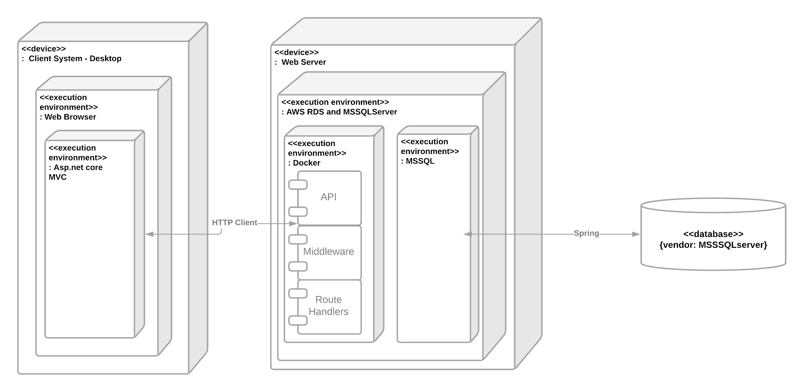
Architecture Diagram

Slide 6
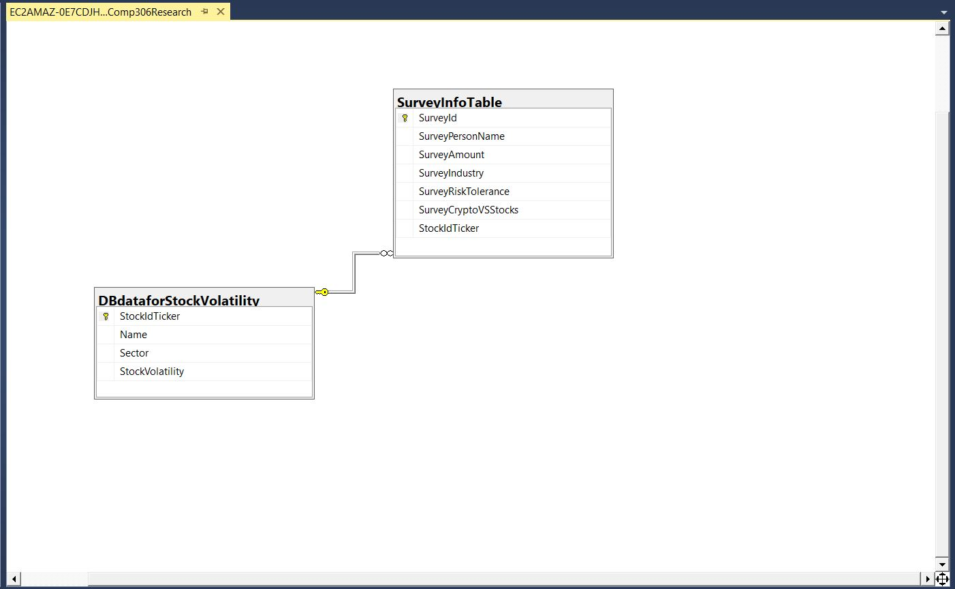
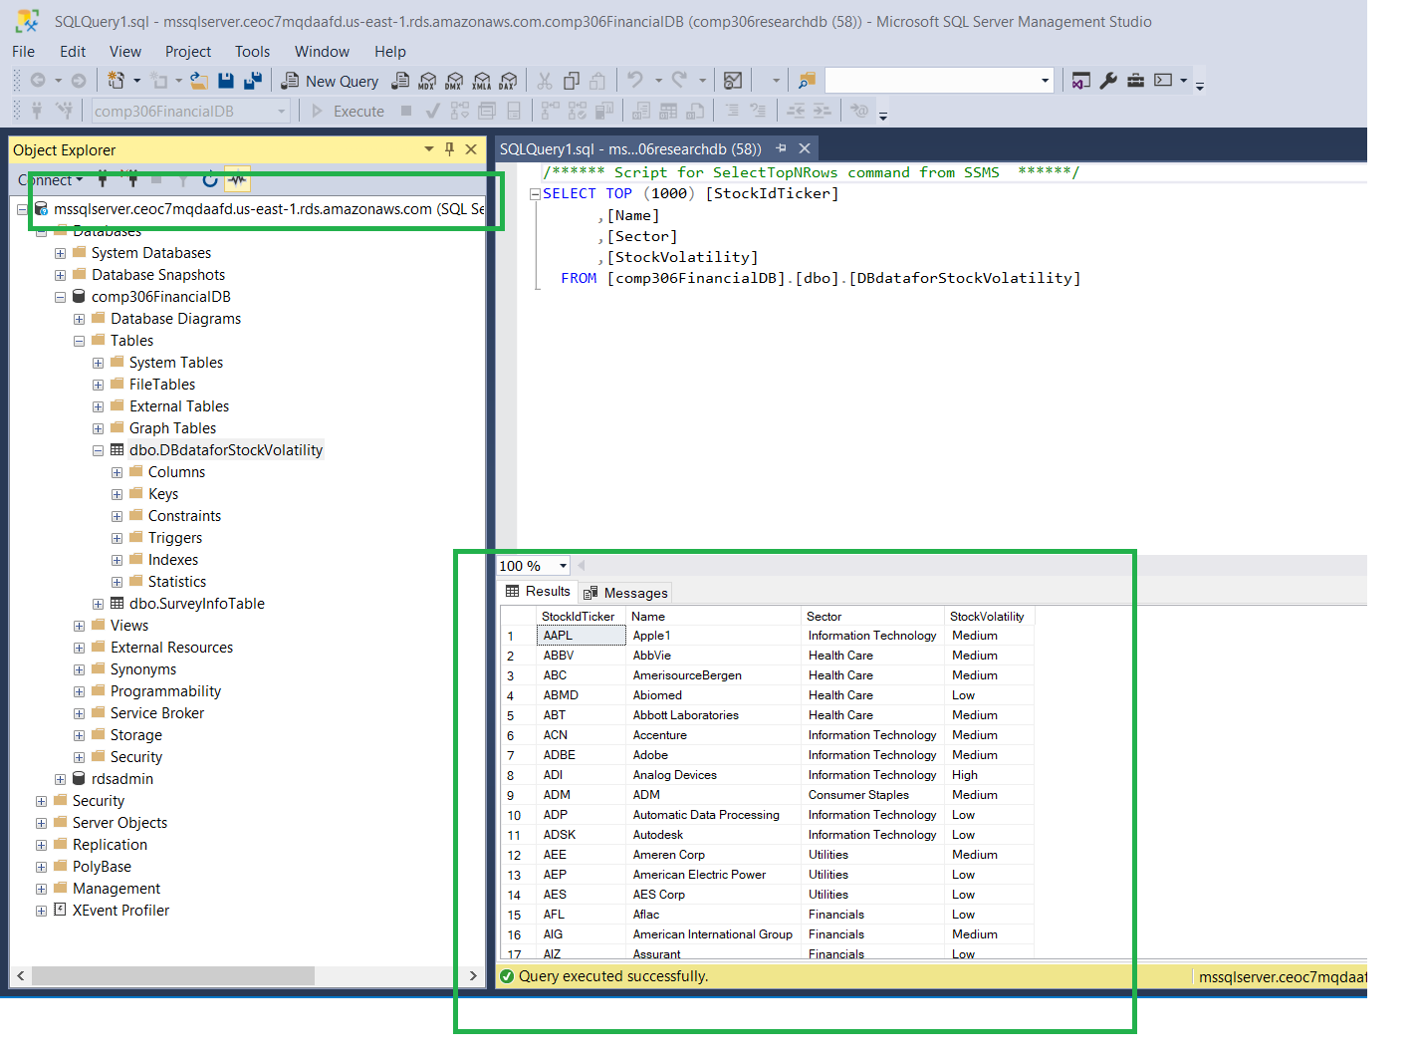
ER Diagram & Database Structure

Slide 7
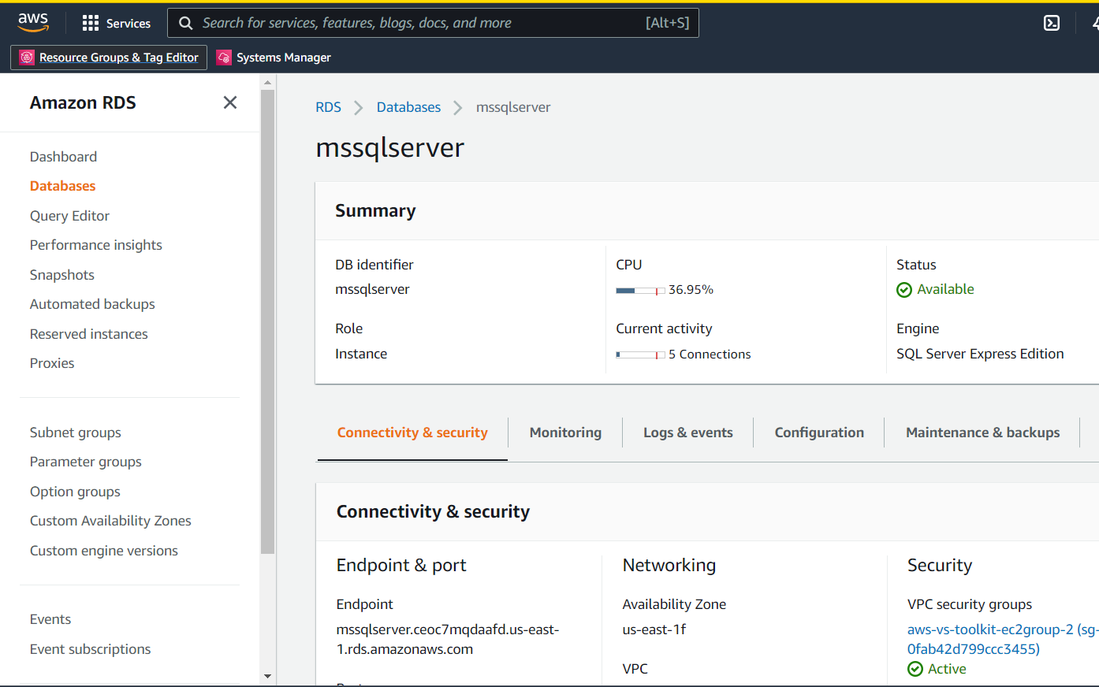
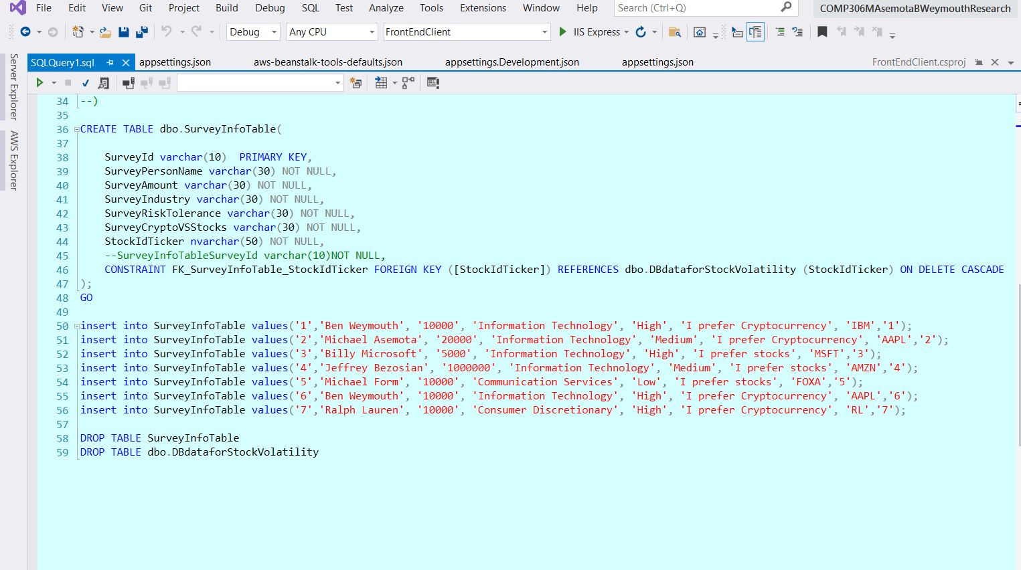
AWS RDS and MSSQL Script

Slide 8

API, Integration and AWS Elastic Beanstalk
For our API we deployed to Elastic Beanstalk
We utilized different endpoints for different elements: such as our financial stock data and our individual survey info.
The next few slides will show our API and our deployment
We utilized the repository pattern, DTO, automapper, dbContext, scaffolding and have 2 controllers
One controller for stock data, one controller for financial survey information

Slide 9
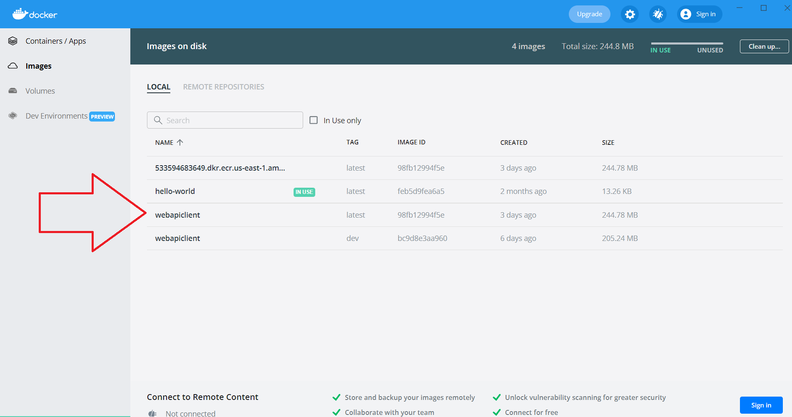
Docker Containerization

Slide 10
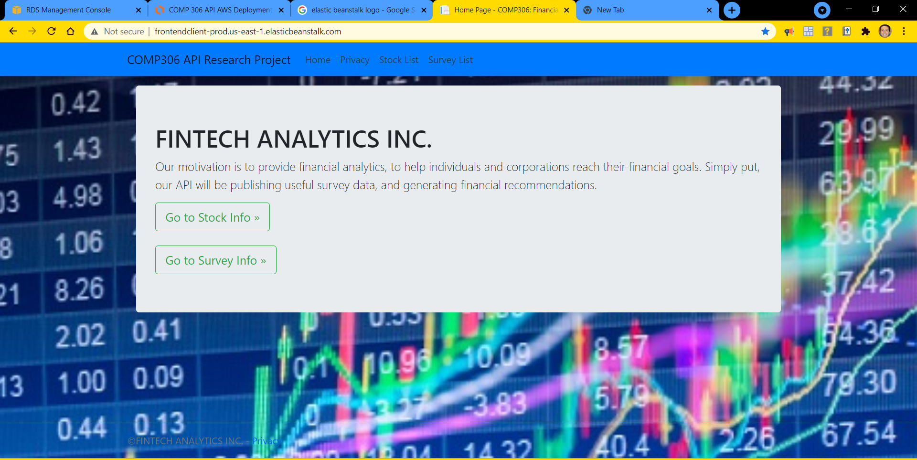
Front End (Consume an API)
Our Front End allows for 5 CRUD operations: get, getbyid, put, post and delete. Each controller implements these 5 operations.
Our solution file has 3 sections: the Front End, the Class Library and the API Client
Both our Front End and our API Client are deployed on Elastic Beanstalk

Slide 11
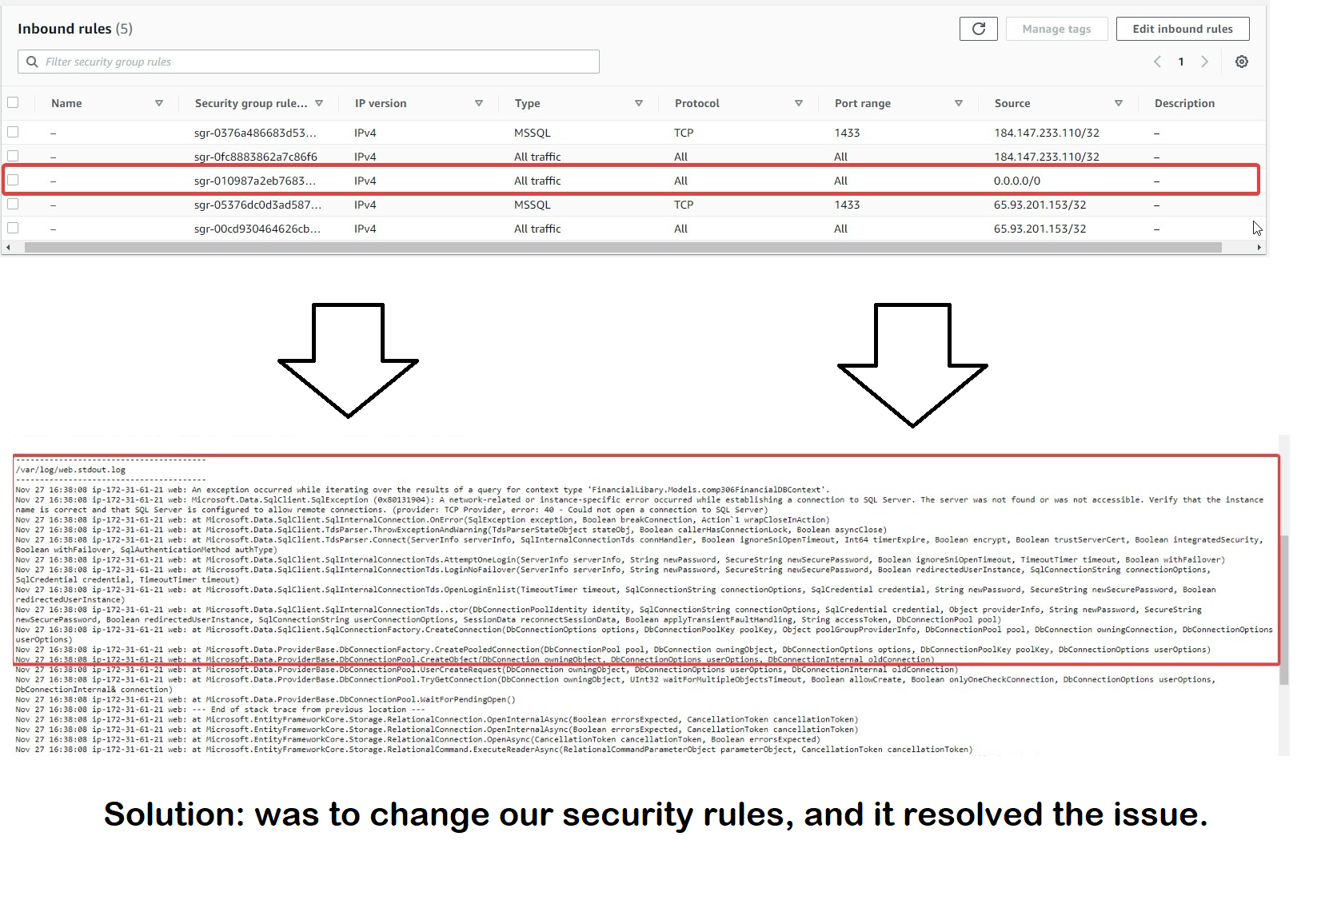
Lessons Learned, Experience Gained
We learnt a lot in terms of API deployment, using docker container, and Asp.net core MVC patterns.
We did lots of debugging and will highlight one example. At one point our endpoints were not generating any data, although the environments were healthy
Solution: we realized our security / accessibility rules needed to be changed and this solved our problem. This is one of the many learning opportunities we had along the way.

Slide 12

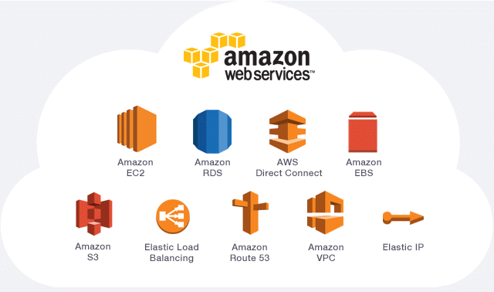

Thank you! -Michael and Benjamin

